Slide 1
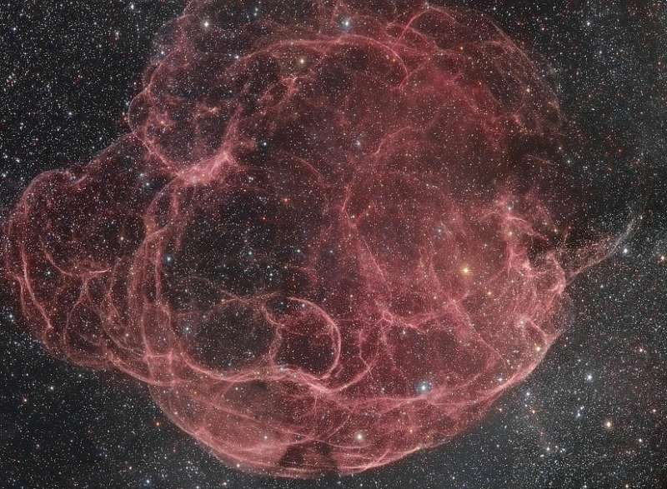
Star formation in the rims of supergiant
HI shells in nearby galaxies
Oleg Egorov^{1,2}
co-laborators: T.A. Lozinskaya¹, A.V. Moiseev^{1,2}, Yu.A. Shchekinov³, G.V. Smirnov-Pinchukov¹
¹Sternberg Astronomical Institute of Lomonosov Moscow State University
²Special Astrophysical Observatory of Russian Academy of Sciences
³Lebedev Physical Institute of Russian Academy of Sciences

Slide 2
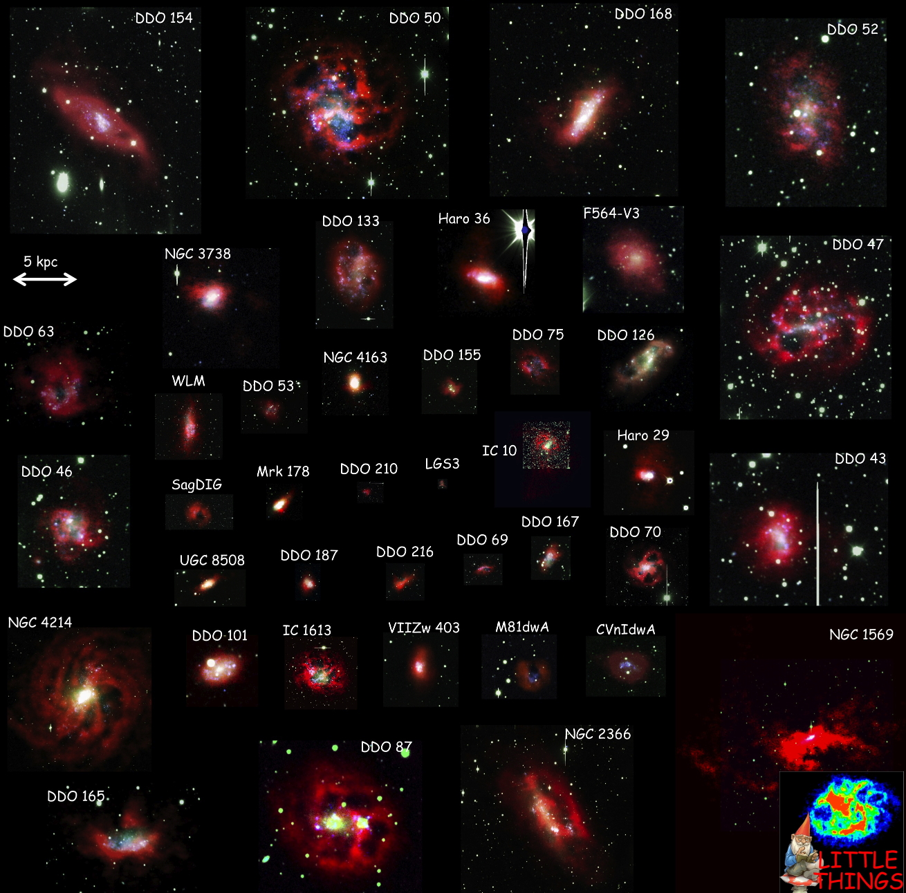
Supergiant shells (SGS) in galaxies
  Supershells result from the cumulative action of multiple stellar winds and supernova explosions
  (Weaver et al. 1977)
  But: the mechanical energy input from the detected stellar cluster is insufficient for most of the SGSs.
  (Tenorio-Tagle & Bodenheimer 1988, Silich et al. 2006 etc.)
  A lot of observed SGS have no any young stars inside.
  Multiple generations of stars are responsible for the creation and driving of SGS (Weisz et al. 2009, Warren et al. 2011)

Slide 3
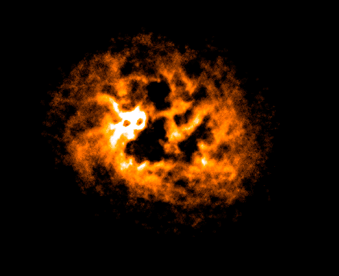
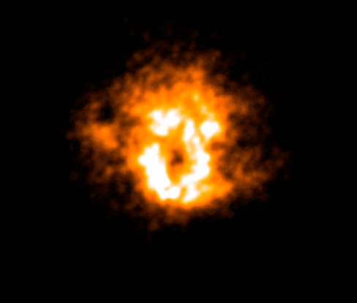
Star formation in SGSs rims
IC 1613
Holmberg I
1 kpc
1 kpc
HI 21 cm (LITTLE THINGS)
HI images reveal a lot of shell-like structures with sizes up to 2-3 kpc.
The regions of triggered star formation are observed in the rims of only some of them

Slide 4
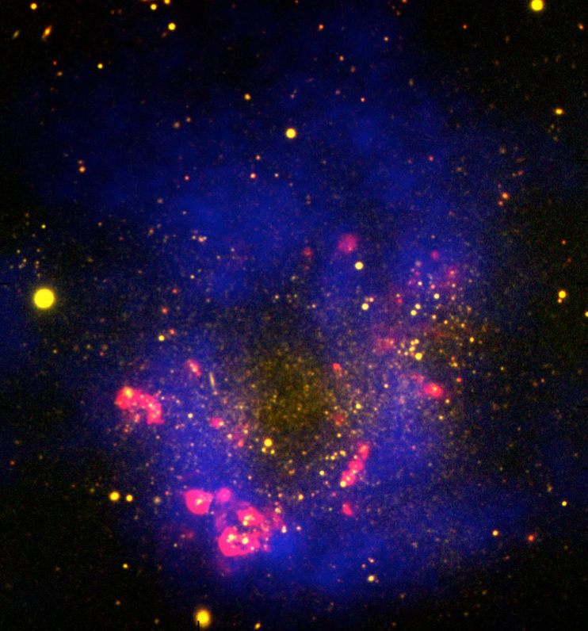
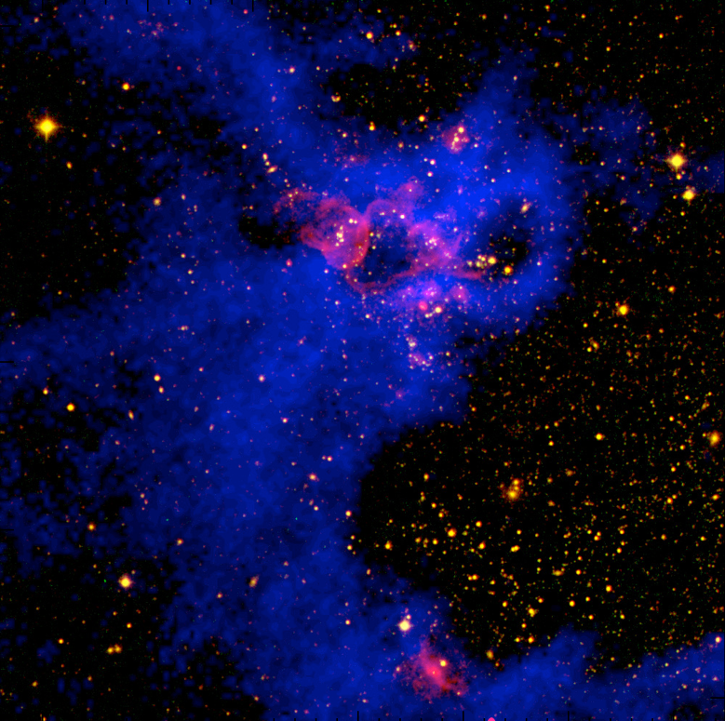
Star formation in SGSs rims
IC 1613
Holmberg I
1 kpc
1 kpc
HI 21 cm (LITTLE THINGS)
H-alpha + HI 21cm + stars
HI images reveal a lot of shell-like structures with sizes up to 2-3 kpc.
The regions of triggered star formation are observed in the rims of only some of them

Slide 5
Star formation in SGSs rims
IC 1613
Holmberg I
H-alpha + HI 21cm + stars
  What triggers the new episode of star formation and how it propagates through SGS?
  How these new episodes of star formation influence the “parent” SGS?

Slide 6
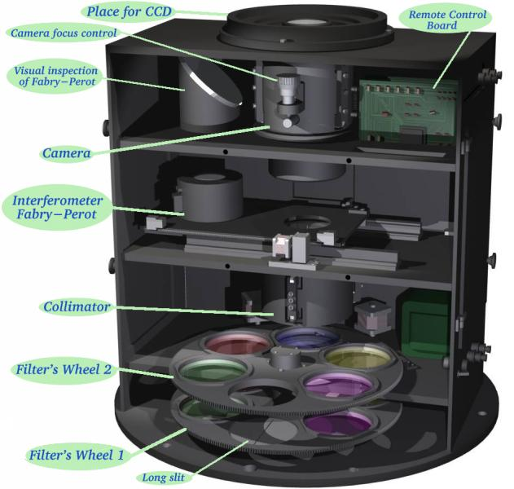
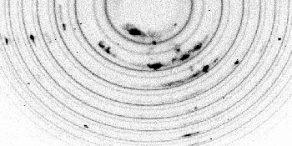
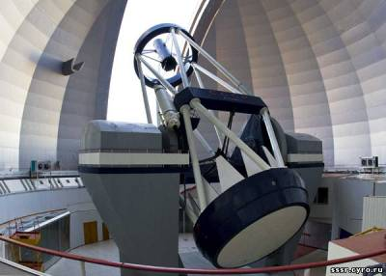
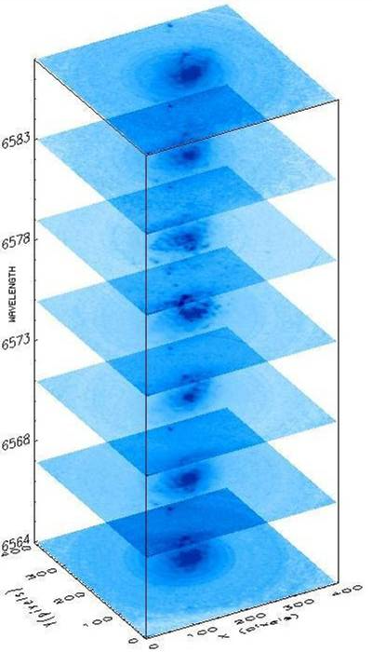
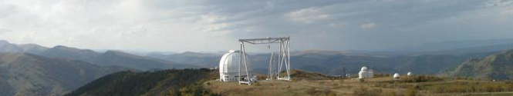
Observations
SCORPIO & SCORPIO-2 multi-mode focal reducers with scanning FPI (Afanasiev & Moiseev, 2005, 2011)
Data reduction:
Moiseev (2002)
Moiseev, Egorov (2008)
Moiseev (2015)
Field of view: 6.1x6.1 arcmin
Spectral range: Hα, [NII], [OIII] and [SII] emission line
Spatial sampling: 0.35-0.70 arcsec/px
Spectral resolution:
R=4000 - 15000
σ= 8.5 - 30.0 km/s
6-m telescope : www.sao.ru

Slide 7
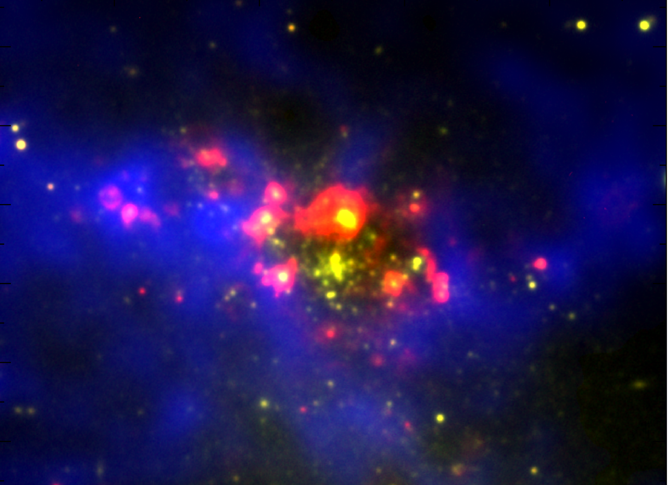
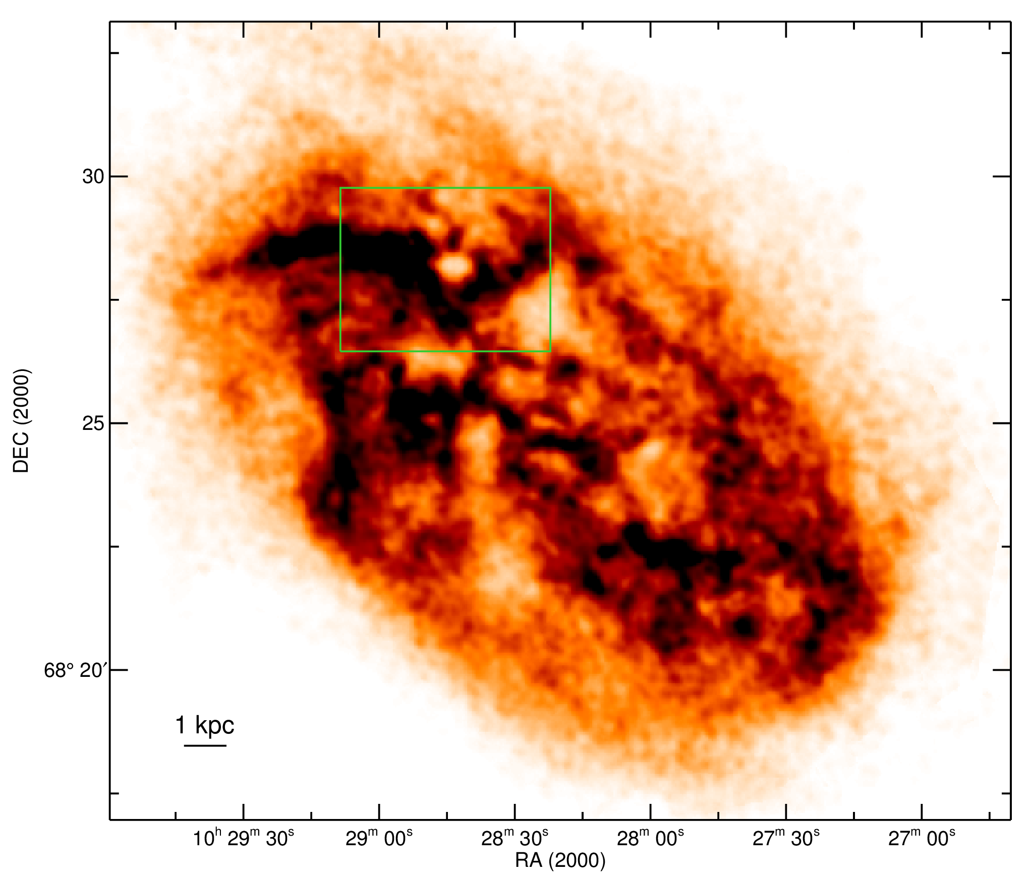
Multiwavelength view on IC2574
IC 2574
H-alpha
HI 21cm
stars
Star formation takes place only in the rim of the relatively young (14 Myr) HI SGS
HI 21 cm
Egorov et al. (2014; MNRAS, 444, 376)

Slide 8
IC 2574: ionized gas kinematics
- Perturbed complex of ionized and neutral gas kinematics observed in overall regions of star formation
- We detected the faint expanding H-alpha kpc-sized supershell in the interior of SGS. Its high [SII]/Ha ratio points to significant contributions of the shocks
H-alpha
500 pc
Egorov et al. (2014; MNRAS, 444, 376)

Slide 9
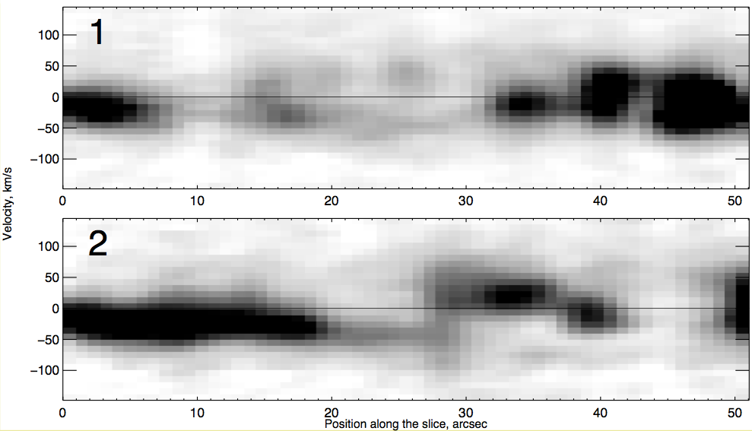
IC 2574: ionized gas kinematics
- Perturbed complex of ionized and neutral gas kinematics observed in overall star formation region
- We detected the faint expanding H-alpha kpc-sized supershell in the interior of SGS. Its high [SII]/Ha ratio points to significant contributions of the shocks
H-alpha
2
1
500 pc
Egorov et al. (2014; MNRAS, 444, 376)

Slide 10
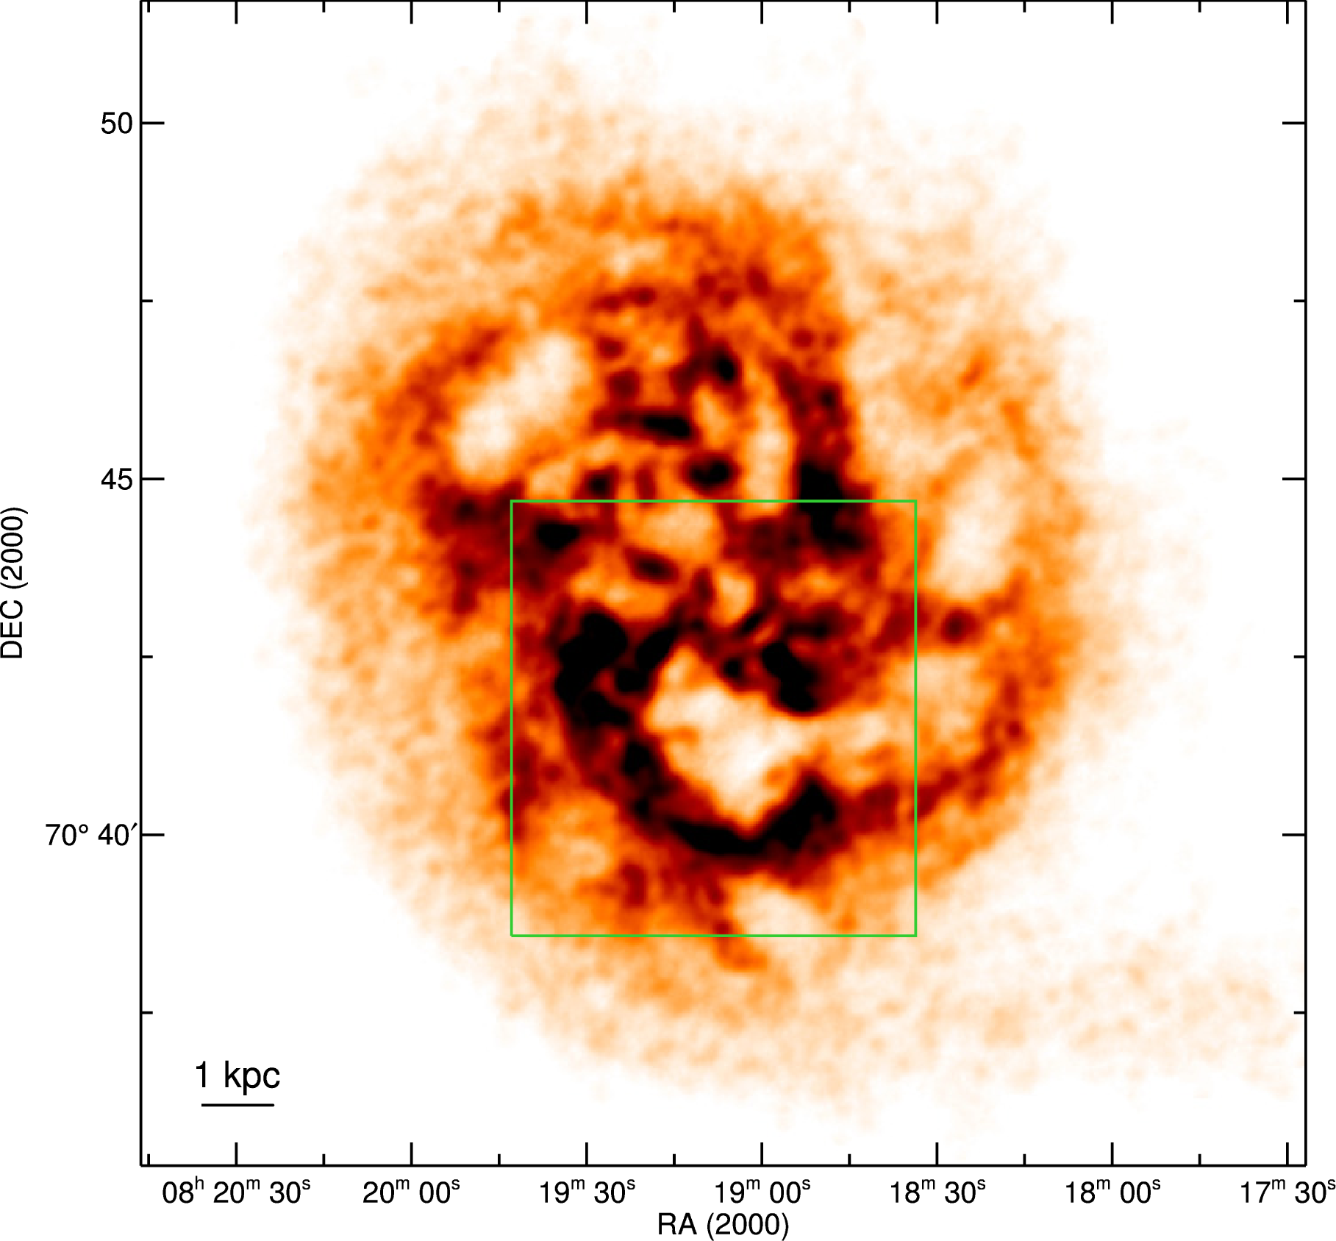
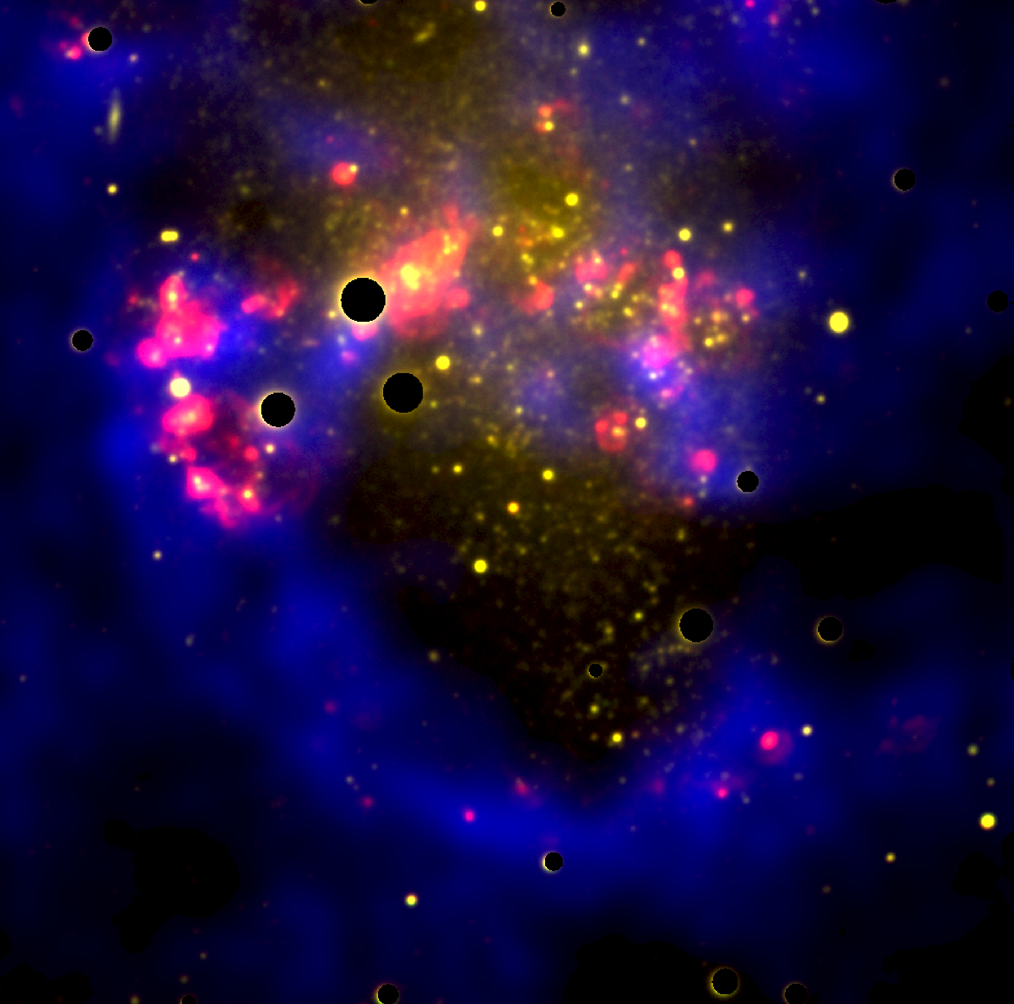
Multiwavelength view on Holmberg II
Holmberg II
H-alpha
HI 21cm
stars
Star forming regions are concentrated in the north rim of the largest old (150 Myr) HI SGS
HI 21 cm
Egorov et al. (2017; MNRAS, 464, 1833)

Slide 11
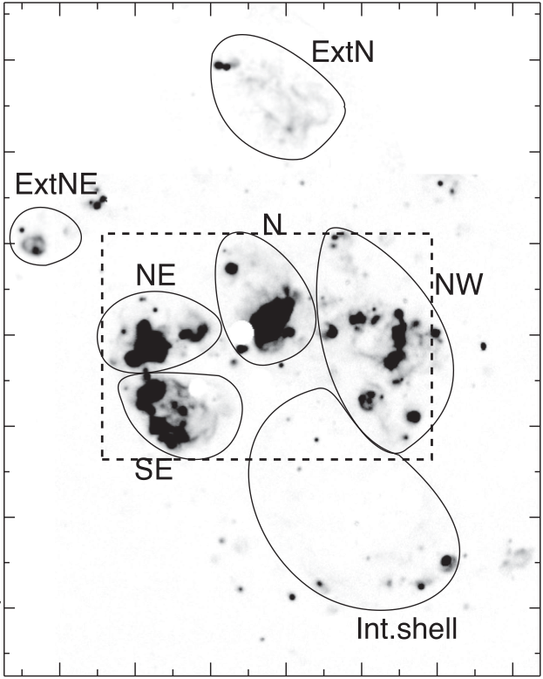
Complexes of SF in Holmberg II
Star formation in Holmberg II occurs not in the chain of the bright HII regions, but in the giant (300-700 pc sized) unified complexes
Bright HII regions inside star forming complexes are tied by faint filamentary structures, surrounded by HI shell and show joint kinematics
Egorov et al. (2017; MNRAS, 464, 1833)

Slide 12
Complexes of SF in Holmberg II
Star formation in Holmberg II occurs not in the chain of the bright HII regions, but in the giant (300-700 pc sized) unified complexes
Bright HII regions inside star forming complexes are tied by faint filamentary structures, surrounded by HI shell and show joint kinematics
Egorov et al. (2017; MNRAS, 464, 1833)

Slide 13
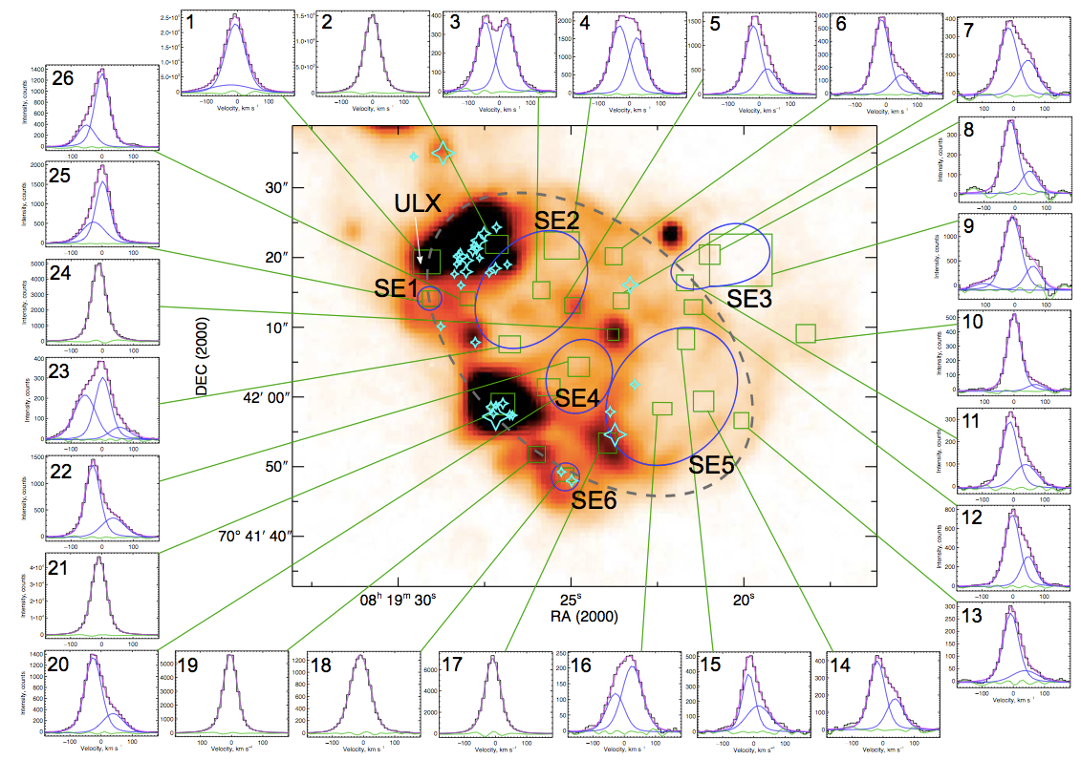
Holmberg II: ionized gas kinematics
500 pc
Egorov et al. (2017; MNRAS, 464, 1833)

Slide 14
Holmberg II: ionized gas kinematics
We found 22 H-alpha expanding superbubbles in Holmberg II. Significant part of them have no central source of mechanical energy => leakage from HII regions should be important.
500 pc
Egorov et al. (2017; MNRAS, 464, 1833)

Slide 15
Holmberg I: complexes of star formation
Bright HII regions inside star forming complexes are tied by faint filamentary structures, surrounded by HI shell and show joint kinematics
Egorov et al. (in preparation)

Slide 16
Holmberg II: 1.5 kpc-sized H-alpha superbubble
- 1.5 kpc-sized ionized supershell located at the inner rim of HI giant superbubble
- Photoionized mechanism of excitation
- 5 OB stars provide almost enough ionizing quanta for ionization of this supershell. Lyman quanta leakage might be also important.
500 pc
Egorov et al. (2017; MNRAS, 464, 1833)

Slide 17
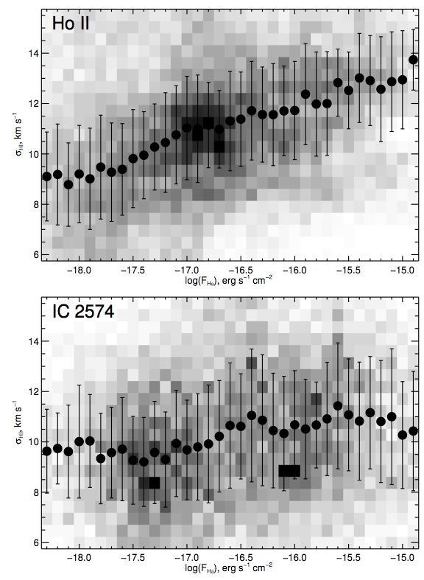
What triggers star formation in SGS?
IC 2574:
  New sites of SF triggered by previous stellar generation
  Turbulence of the ISM do not correlates with ΣSFR
Holmberg II:
  Opposite to IC2574, dispersion of H-alpha clearly correlates with ΣSFR
  Probably, star formation was triggered by neutral shells collision
Egorov et al. (2017; MNRAS, 464, 1833)

Slide 18
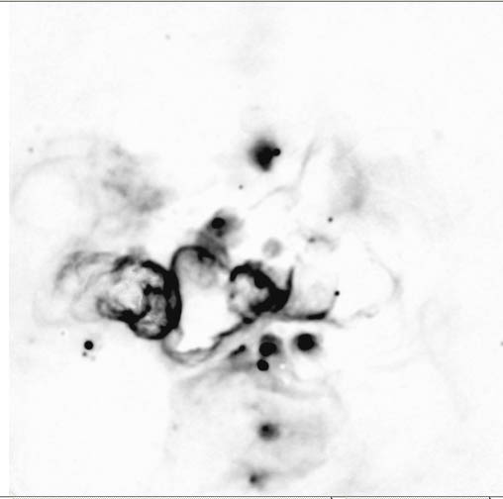
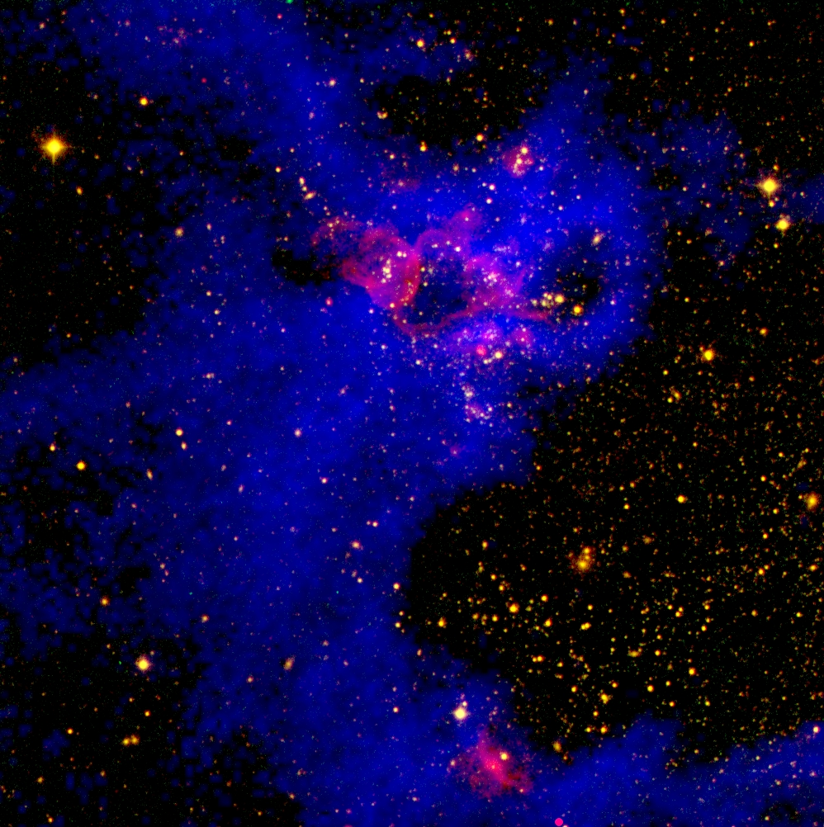
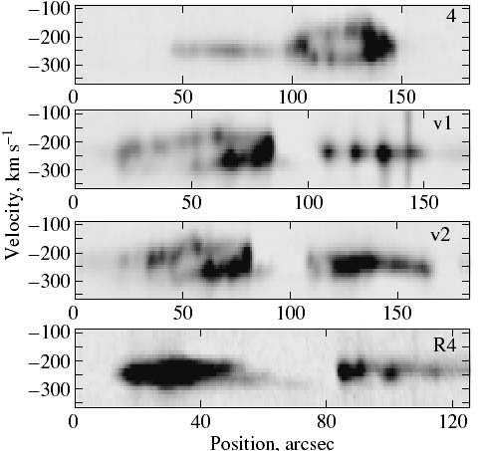
IC1613: SF triggering
1
4
2
3
1
2
Star formation triggered by HI shells collision
500 pc
3
H-alpha + HI 21 cm + continuum
4
Age of shells
HI: 5.3-5.6 Myr,
HII: 0.6-2.2 Myr
Lozinskaya et al. (2003)

Slide 19
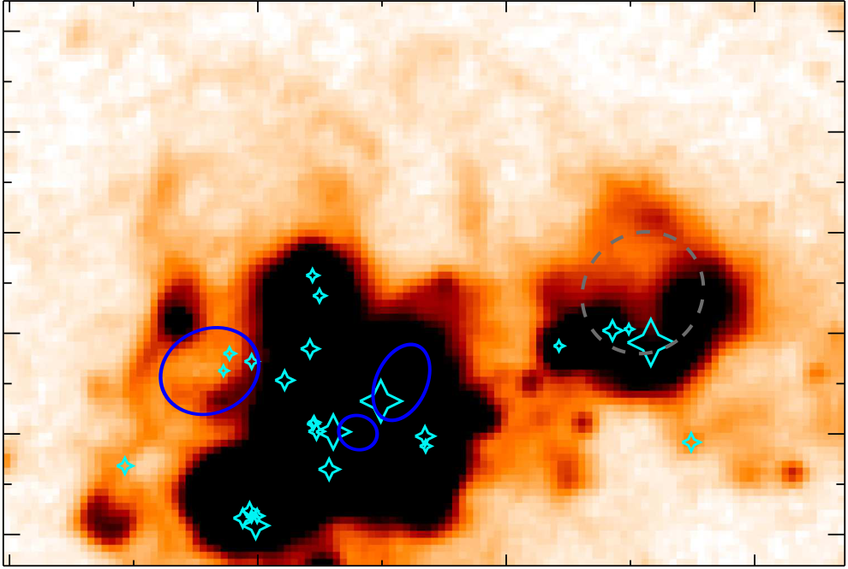
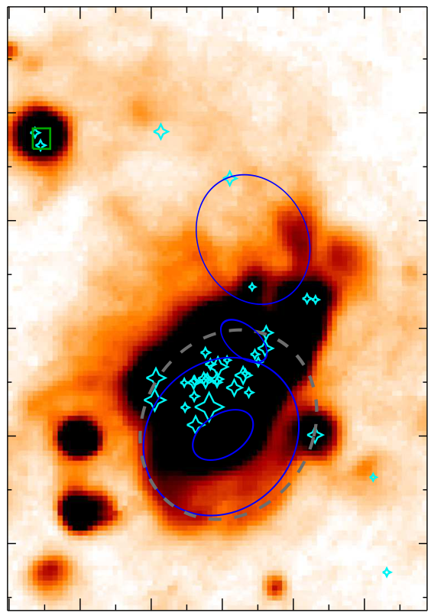
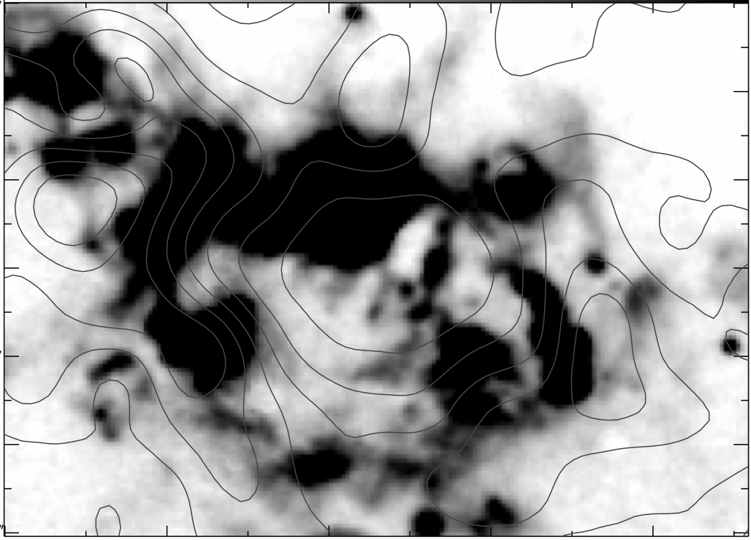
Influence of ongoing SF on the HI SGS:
Holmberg II
Subsequent destruction and merging of HI SGSs is probable
IC 2574
Egorov et al. (2014, 2017)

Slide 20
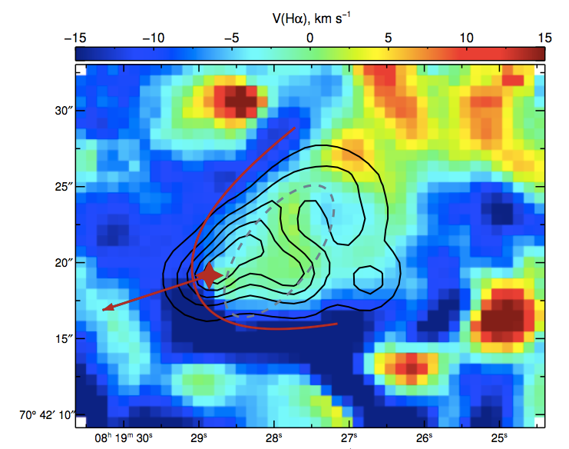
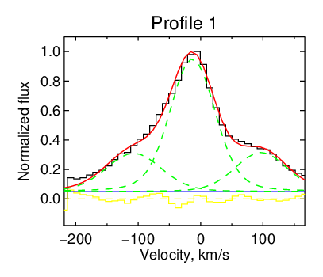
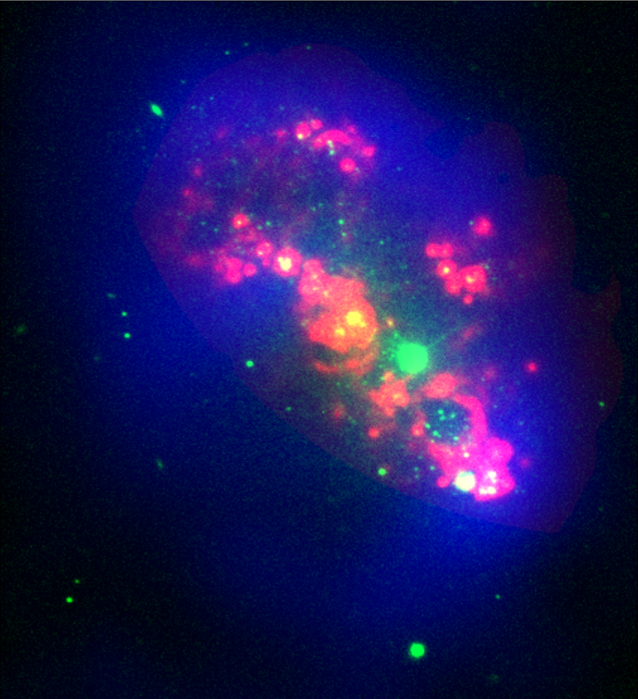
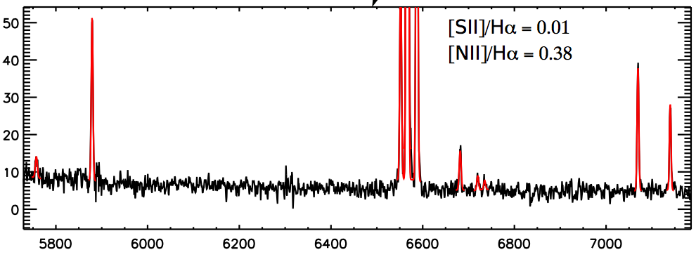
Searching the individual unique objects and studying of their feedback to ISM
See my poster S12.8
Scanning FPI is effective instrument for searching the unique energetic sources (ULX, WR stars, SNR, LBV) and studying their feedback to the ISM
Egorov et al. (2014; MNRAS, 444, 376)
Egorov et al. (2017; MNRAS Letters, 467, L1)
Moiseev et al. (in prep); Egorov et al. (in prep)

Slide 21
Summary
Only part of SGS in the nearby galaxies reveals the regions of ongoing star formation. It could be triggered by the feedback from previous generations of stars or by the neighboring SGS collision.
The ongoing star formation influences on the morphology and subsequent evolution of the “parent” HI SGS and might destroy it.
A lot of faint expanding superbubbles are observed in star formation regions. Mechanical energy leakage from the bright HII regions should be the main power source for significant number of them.
We detected kpc-sized faint ionized supershell inside the HI holes in Holmberg II and IC 2574 galaxies. Their excitation mechanisms are different. One of the probable sources of their creation is a LyC quanta escape from the bright HII regions.
Thanks for your attention!

